Slide 1
Improving Deep Neural Networks
Deep Learning Specialization Report
Toshiba Software Development (Vietnam) Co., Ltd.
2021-10-05

Slide 2
Contents
01
Practical Aspects of Deep Learning
02
Optimization Algorithms
03
Hyperparameter Tuning, Batch Normalization and Programming Frameworks
04
Questions

Slide 3
Practical Aspects of Deep Learning
01

Slide 4
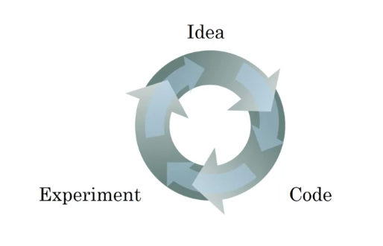
1.1 Train / Dev / Test sets
Applied Machine Learning (ML) is a highly iterative process.
model generalization.
Splitting into train, dev & test sets:
Training sets: to build model.
Dev sets (validation sets): to optimize hyperparameters
Test sets: try & evaluate.
Notes:
Dev & test set from same distribution.
The trend on the ratio of splitting the models:
100 ≤ #datasets ≤ 10^6 => 60%/20%/20%.
#datasets ≥ 10^6 => 98%/1%/1%.
The factors determining ML’s ability:
Make the training error small.
Make the gap between training & test error small.
Notes:
+ Quá trình (process): start idea (identify problems, proposal algorithms, design 1 nn(input, output)) -> implement -> run & experiment get a result tell how well this particular networks or config. Try to find better neural network for application.
=> Goals (stop position): generalization ~ ability to perform well on previously unobserved inputs
+ (?) làm sao để quá trình trên trở lên hiệu quả.
solve: setting dataset can make u more efficient.
3) Why ?
+ same distribution:
+

Slide 5
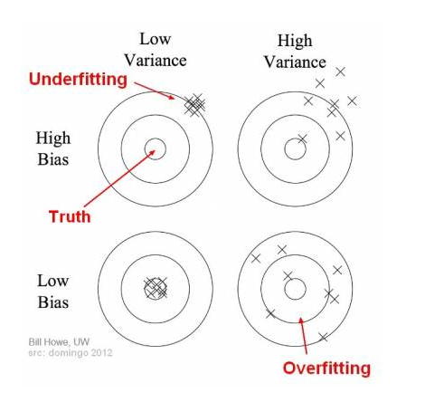
1.2 Bias/Variance (1)
Definition:
Bias: the difference between the average prediction & the correct value.
Variance: the variability of model prediction for a given data point which tells spread of our data.
Problems:
Overfitting: occurs when the gap between the training error & test error is too large.
Underfitting: occurs when the model is not able to obtain a sufficiently low error value on the training set.
The bias variance trade-off: try to find a good balance between bias & variance such that it minimizes the total error:
Total Error = ${Bias}^{2}$ + Variance + Irreducible Error (*)
Notes:
What
+ high bias -> models not focus training data & oversimplifies the model.
+ high variance -> du lieu thua thot
2) Why occur ?
+ capture: catch
+ overfitting: model learn the detail & noise in the training data to extent that it negatively impacts the performance of the model on new data. Model more complexity,
+ underfitting: model too simple.
3) Model’s capacity la kha nang model “fit” nhieu loai functions.
Low capacity -> kho khan fit training data
High capacity -> overfitting ~ ghi nho cac dac trung cua training data ma k hieu qua tren test set.

Slide 6
1.2 Bias/Variance (2)
How to detect:
Overfitting: using k-folds cross validation:
One of the k-folds as the test set & the remaining folds as training set.
The process repeats util each of the fold has acted as a test set.
The scores are averaged to assess the performance of the overall model.
If the model performs better on the training set than on the test set => model is likely overfitting.
Underfitting:
Based off the training set.
How to avoid:
Overfitting:
Cross-validation
Early stopping
Train with more data
Data augmentation
Regularization
Underfitting:
Decrease regularization
Increase the duration of training
Feature selection
Notes:
What ?
+ control the capacity of learning algorithm = choosing “hypothesis space”.
Hypothesis space: the set all functions that can be returned by model.
- Example:

Slide 7
1.3 Basic recipe for machine learning
After having trained an initial model
High bias
1. Try bigger network
2. Train longer
3. Try difference NN architecture
Yes
No
High variance
1. More data
2. Regularization
3. Try difference NN architecture
Yes
Done
Notes:
Recipe: formula
Goal: both low bias & low variane

Slide 8



1.4 Regularizing (1)
Regularizations are techniques used to reduce the error by fitting a function appropriately on the given training set & avoid overfitting.
Regularization for logistic regression:
Cost function:
The L2 regularization:
The L1 regularization:
Notes:
What:
+ Overfitting:
+ Solves: regularization or more training data.
2) Why using ?
+

Slide 9
1.4 Regularizing (2)
Model’s capacity:
The ability to fit a wide variety of functions.
Notes:
What:
+ Model capacity:
Low capacity -> struggle to fit the training set.
High capacity -> memorizing properties of training set do not serve them well on the test set.

Slide 10
1.4 Regularizing (3)
Regularization for Neural Networks:
Cost function:
The L2 regularization:
The L1 regularization:
Notes:
What:
+ Overfitting:
+ Solves: regularization or more training data.
2) Why using ?
+ regularization: giam so luong models

Slide 11
Optimization Algorithms
02
Notes:
+ thao luan cac thuat toan toi uu giup tang toc do train model -> tang toc qua trinh

Slide 12

2.1 Mini-batch Gradient Descent (1)
Vectorization allows us to efficiently compute on m examples. Consider m=5,000,000:
Batch: all datasets
Mini-batch: subsets of datasets.
Example: Batch=5*10^6 ; mini-batch=1000; number of batches = 5000
Mini-batch Gradient Descent:
Run the gradient descent on the mini datasets.
Mini-batch algorithms pseudo code:
Notes:
What:
+ vectorization: refers to Single Instruction & Multiple Data (?). Nhung khi large data -> take a huge processing time.
+ gradient descent process:
Initialize start points theta_0.
Update theta (loop) – using all data points
2) Why ?

Slide 13
2.1 Mini-batch Gradient Descent (2)
Vectorization
Notes:
What:
+ vectorization: refers to Single Instruction & Multiple Data (?). Nhung khi large data -> take a huge processing time.
+ gradient descent process:
Initialize start points theta_0.
Update theta (loop) – using all data points
2) Why ?

Slide 14
2.2 Exponentially Weighted Averages
Notes:
What:
+ Overfitting:
+ Solves: regularization or more training data.
2) Why using ?
+ regularization: giam so luong models

Slide 15
2.3 Bias Correction in Exponentially Weighted Averages
Notes:
What:
+ Overfitting:
+ Solves: regularization or more training data.
2) Why using ?
+ regularization: giam so luong models

Slide 16
2.4 Gradient Descent with Momentum
Notes:
What:
+ Overfitting:
+ Solves: regularization or more training data.
2) Why using ?
+ regularization: giam so luong models

Slide 17
2.5 RMSProp
Notes:
What:
+ Overfitting:
+ Solves: regularization or more training data.
2) Why using ?
+ regularization: giam so luong models

Slide 18
2.6 Adam Optimization Algorithms
Notes:
What:
+ Overfitting:
+ Solves: regularization or more training data.
2) Why using ?
+ regularization: giam so luong models

Slide 19
2.7 Learning Rate Decay & The Problem of Local Optimal
Notes:
What:
+ Overfitting:
+ Solves: regularization or more training data.
2) Why using ?
+ regularization: giam so luong models

Slide 20
Thank you

